Slide 1
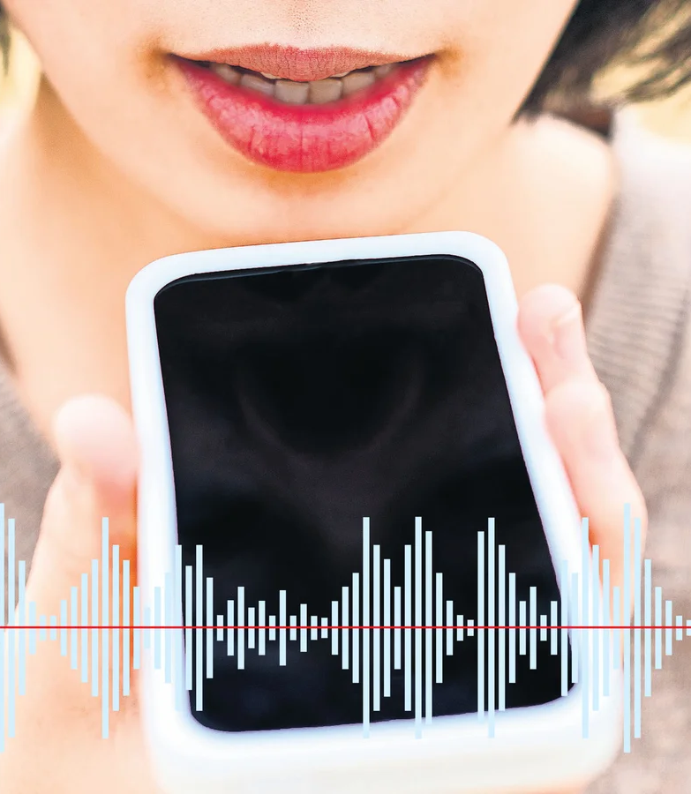
Speech-Text-Emotion Recognition on Voice Messages
Guide: Dr. Pramod Mehra
Student: Anmol Rawat
University Roll No: 2023251
Institution: Graphic Era Deemed to be University.
Academic Year: 2024-25

Slide 2
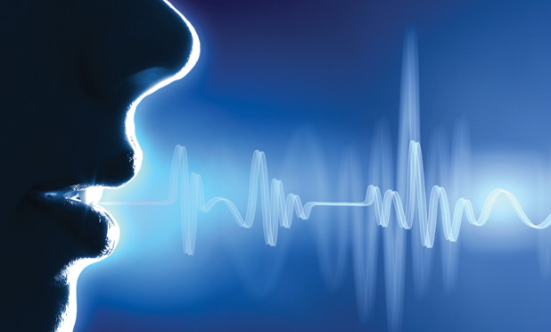
Introduction
In an era dominated by digital communication, voice messages have become an integral medium for expressing thoughts and emotions. However, existing systems fail to capture the underlying emotional context, leading to impersonal communication. This project focuses on building a Speech-Text-Emotion Recognition System that combines speech-to-text conversion and emotion classification models to interpret emotions in voice messages accurately.
Applications include virtual assistants, mental health systems, and customer service platforms, enhancing user experiences through empathetic and emotionally aware systems.

Slide 3

Problem Statement
Despite significant advancements, emotion recognition from voice messages remains challenging due to:
Speech Variability: Differences in tone, pitch, and accent.
Linguistic and Cultural Differences: Emotional expression varies across regions.
Ambiguity in Emotions: Overlapping emotional states.
Dataset Imbalance: Underrepresentation of subtle emotions like fear or disgust.
The goal is to address these issues by developing a robust, multilingual, and scalable emotion detection system using machine learning models.

Slide 4

Literature Survey
This project leverages Natural Language Processing (NLP) and Machine Learning (ML) techniques to identify emotions effectively.
Dataset: GoEmotion Dataset [2] (60,000+ samples, 7 core emotions).
Speech-to-Text Conversion: Audio inputs transcribed using SpeechRecognition Library.
Text Preprocessing: Tokenization, stop-word removal, and TF-IDF feature extraction.
The combination of high-quality datasets and robust preprocessing ensures meaningful text representations for emotion detection.

Slide 5

Literature Survey
Model Choice: Logistic Regression for emotion classification. [1]
Multilingual Support: Deep-Translator manages inputs in multiple languages (e.g., English, Hindi).
Evaluation Metrics: Accuracy, Precision, Recall, F1-Score.
These methodologies ensure the system’s adaptability, accuracy, and scalability for real-world scenarios.

Slide 6

Objectives of the project
The project aims to develop a real-time Speech-Text-Emotion Recognition System with the following objectives:
1. Accurately classify emotions from voice and text inputs. 2. Support multilingual data processing. 3. Integrate the model with a Discord Bot for live interaction. 4. Optimize model performance using key evaluation metrics (Accuracy, Precision, Recall). By meeting these objectives, the project contributes to enhancing AI-driven emotional intelligence.

Slide 7
Project timeline
Dataset Preparation Loading the GoEmotions dataset, preprocess it by determining the dominant emotion for each text, and clean any missing data.
Feature Engineering Transforming text into TF-IDF vectors using TfidfVectorizer. Address class imbalance with SMOTE.
Model Training Training a Logistic Regression model on balanced data. Evaluate its performance using a classification report and confusion matrix.
Model Saving Saving of trained model and vectorizer as a .pkl file for reuse.
Prediction Loading the saved model and vectorizer to predict emotions for input text or transcribed voice messages. Visualize top two predictions in a pie chart.
Voice Message Handling Converting the voice files to text using SpeechRecognition and translate them into English before predicting emotions.
Discord Integration A bot listens for text or voice messages, processes them for emotion analysis, and reacts with emojis for predicted emotions.

Slide 8

Project Work Carried Out
Dataset Used:
GoEmotion Dataset: Over 60,000 text samples annotated with 7 primary emotions.
Preprocessing Audio Data: SpeechRecognition for audio transcription.
Data Handling Techniques:
Tokenization and stop-word removal.
TF-IDF feature extraction.
Class imbalance addressed using SMOTE (Synthetic Minority Over-sampling Technique).
The dataset was carefully curated to ensure diversity and representational fairness across emotions

Slide 9
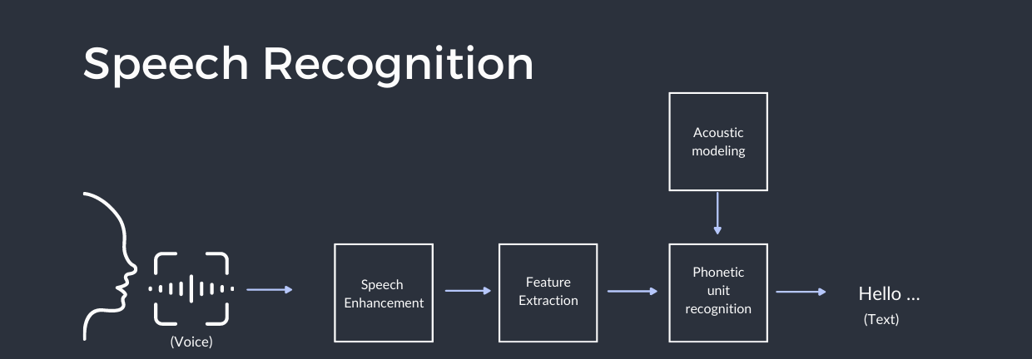
Project Work Carried Out
Audio Preprocessing:
Noise reduction for cleaner audio signals.
Accurate transcription via SpeechRecognition.
Text Preprocessing:
Text cleaning (punctuation and stop-word removal).
Tokenization for word-level analysis.
TF-IDF vectorization for numerical feature representation.
These preprocessing steps transformed raw inputs into structured data ready for machine learning analysis.

Slide 10

Project Work Carried Out
Model Architecture
Logistic Regression with TF-IDF for text feature extraction.
SMOTE used to handle class imbalance.
Integrated within a Scikit-learn pipeline for streamlined preprocessing and training.
Training Process
Cleaned and preprocessed data, assigning dominant emotion labels.
Applied TF-IDF vectorization (10,000 max features).
Balanced dataset using SMOTE.
Split into Training (80%) and Testing (20%) sets.
Trained Logistic Regression with L2 regularization and 1000 max iterations.
Evaluated using classification reports and confusion matrices.
Saved the trained model and vectorizer for reuse.

Slide 11
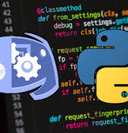
Project Work Carried Out
The model was integrated into a Discord Bot Interface for real-time deployment.
Workflow:
Voice messages are transcribed using SpeechRecognition.
Preprocessed text is passed into the model for classification.
Detected emotions are represented using emojis and confidence scores.
Technologies Used:
Python
SpeechRecognition
Discord API
DeepTranslator

Slide 12

Project Work Carried Out
Key Challenges:
Multilingual speech variations.
Noise in audio transcription.
Dataset imbalance affecting rare emotions.
Solutions Implemented:
Translation APIs for handling multiple languages.
Noise reduction techniques for cleaner transcriptions.
SMOTE for addressing dataset imbalances.
These solutions strengthened the reliability and versatility of the system.

Slide 13
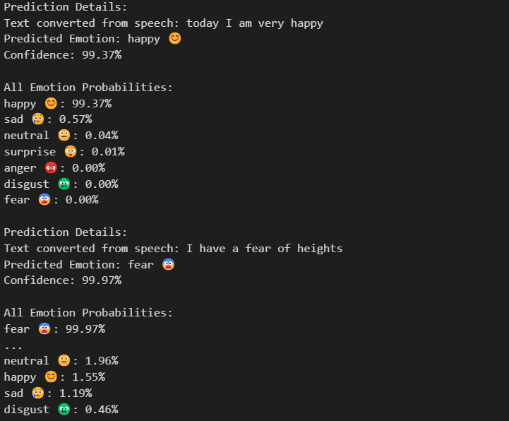
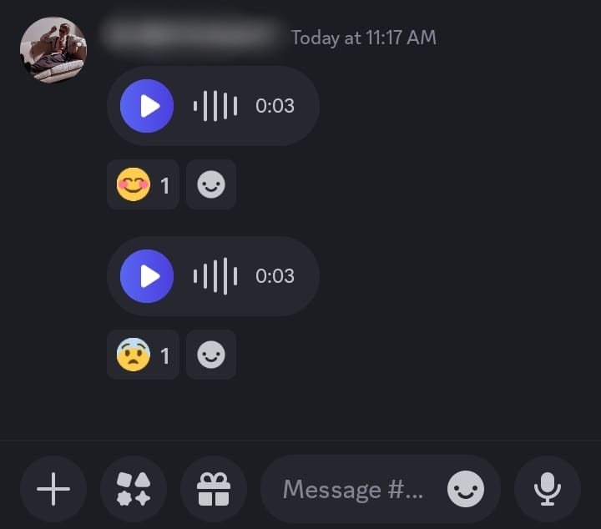
Results and Discussion
This Model claimed an Accuracy : >=95% for common emotions.

Slide 14

Conclusion & Future Work
Conclusion: This project successfully demonstrates real-time emotion detection from voice messages, integrating speech-to-text conversion and machine learning models effectively.
Future Enhancements:
Dataset expansion for rare emotions.
Improved speech transcription tools.
Cross-platform mobile app deployment.

Slide 15
REFERENCES
[1] Vaughn, Percy. Essentials of Machine Learning. Larsen & Keller Education, 2023, pp. 92–153. [2] Chanda, D. (2021). GoEmotions: A dataset for fine-grained emotion classification. Kaggle. GoEmotions Dataset. [3] Hugging Face, Inc. (2024). Hugging Face. Hugging Face Website.

Slide 16
THANK YOU

